Slide 1



Forest Cover Type Classification
Anas Elbattra | 300389368
Ahmed Badawy | 300389393
Esraa Fayad | 300389888

Slide 2


Table of Contents
01
Problem Overview
02
Dataset Overview
03
Flowchart
04
Problem Nature
05
Conclusion

Slide 3
01
Problem overview

Slide 4
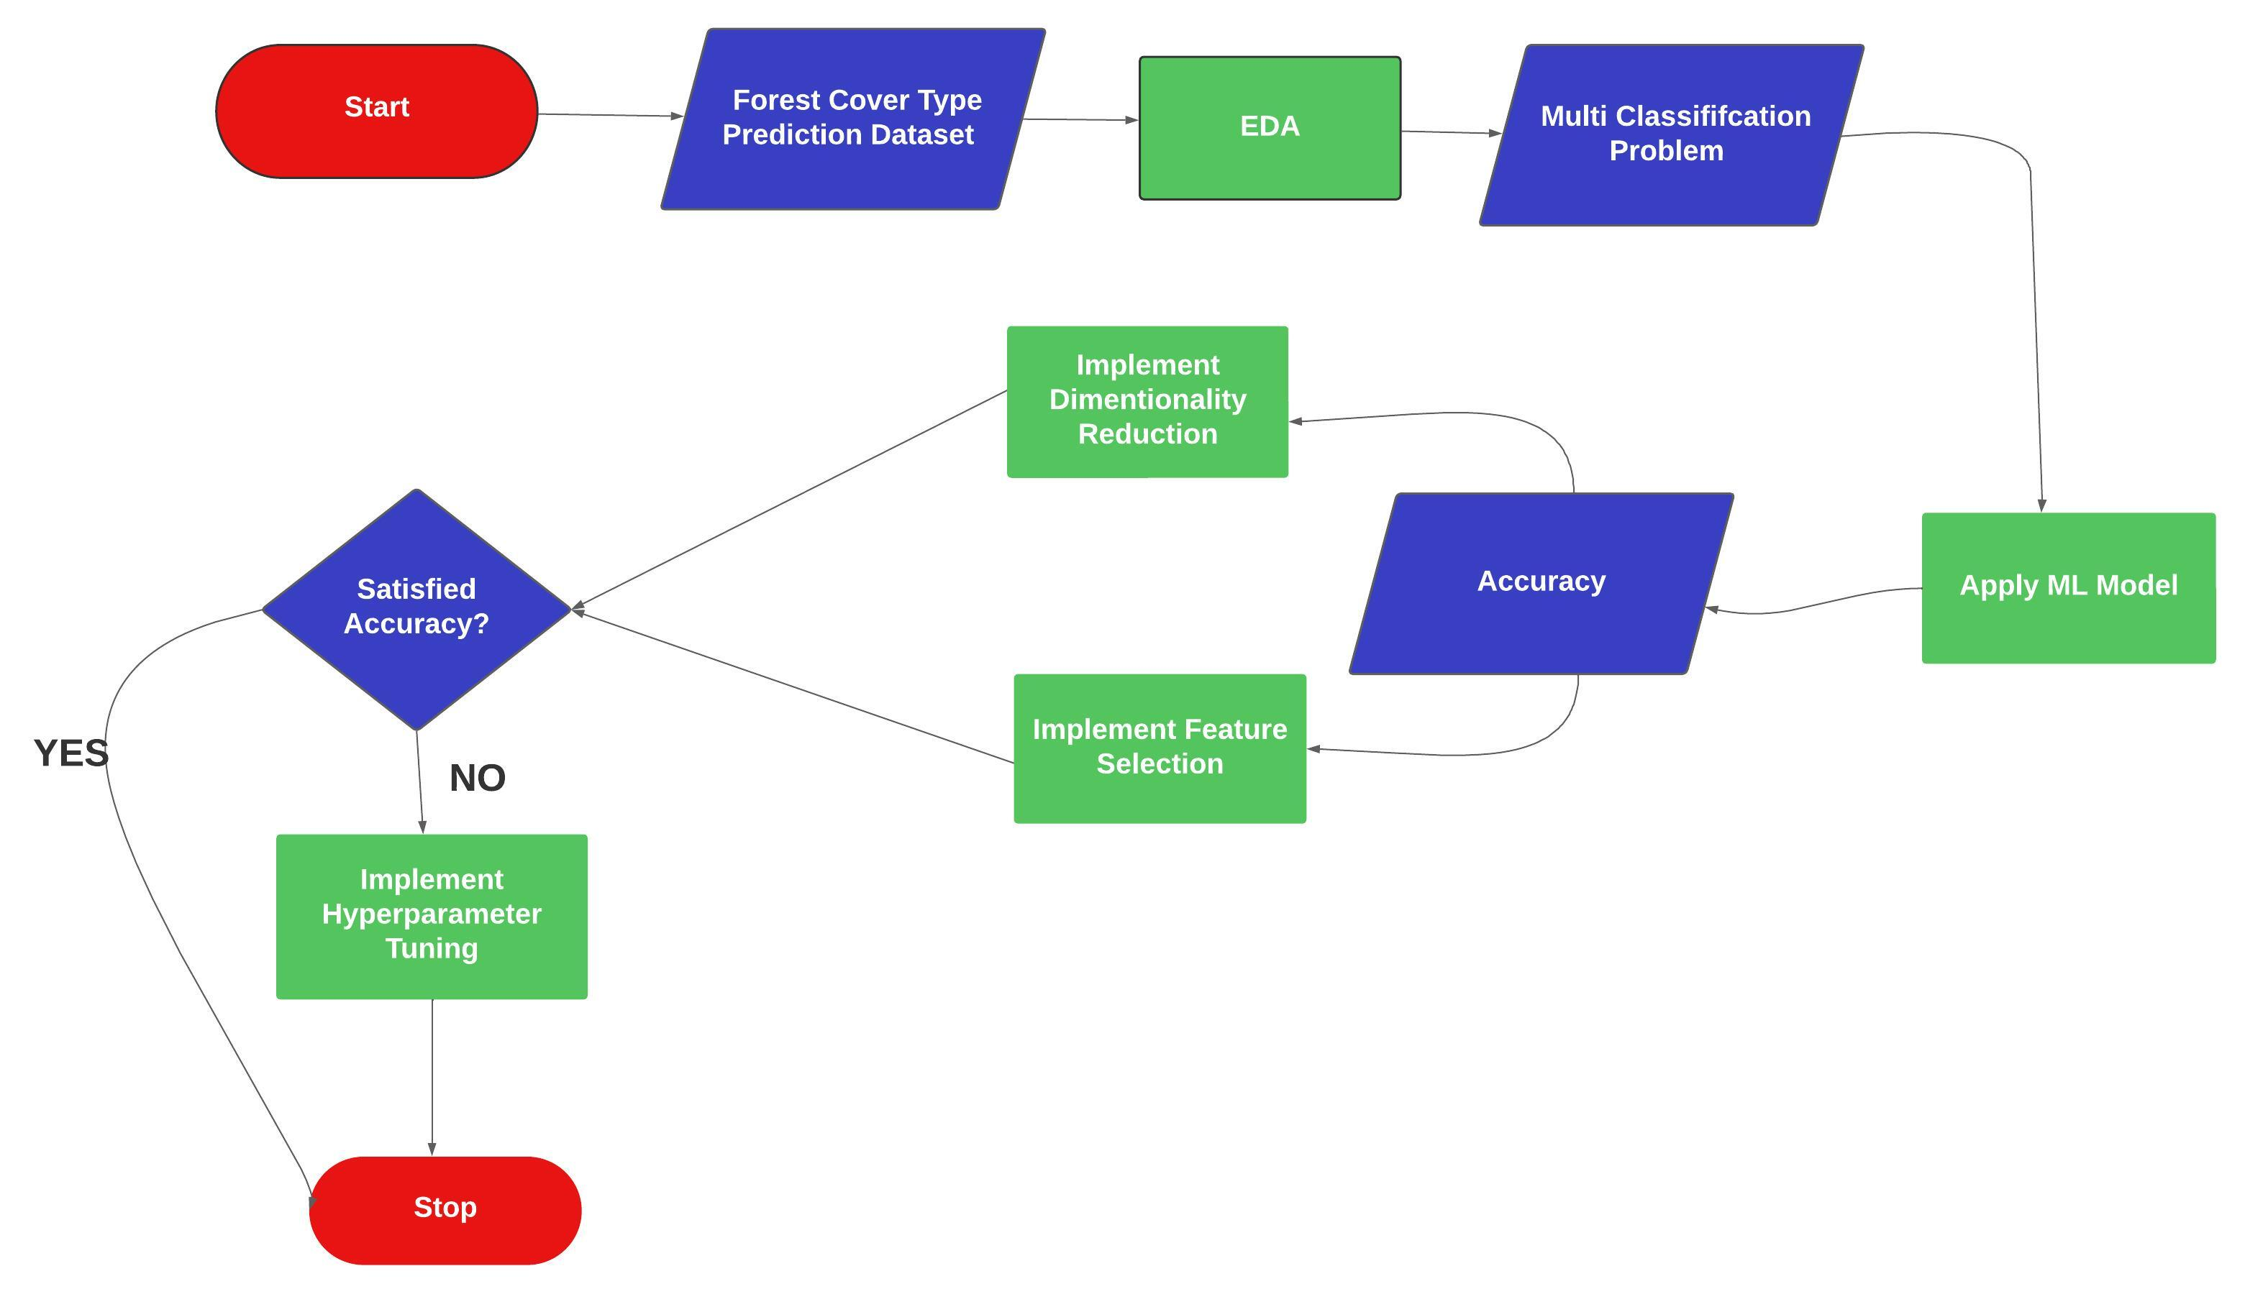
Explaining Idea

Slide 5
02
Dataset overview

Slide 6
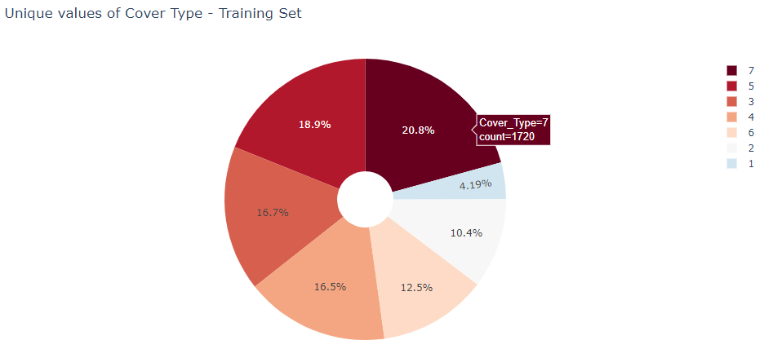
Count Of Each Cover Type

Slide 7
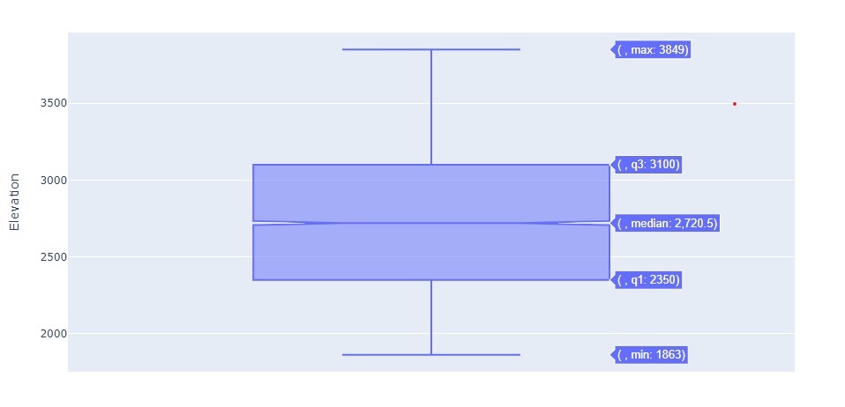
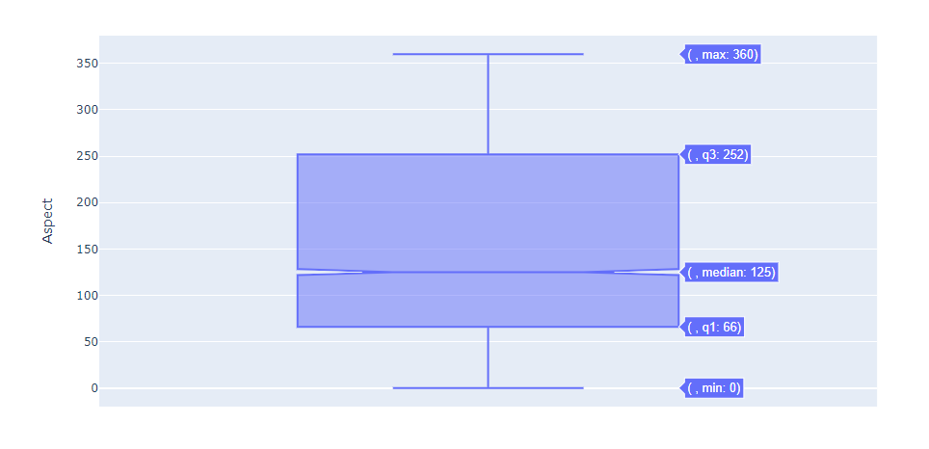
Box Plot For Training Data

Slide 8
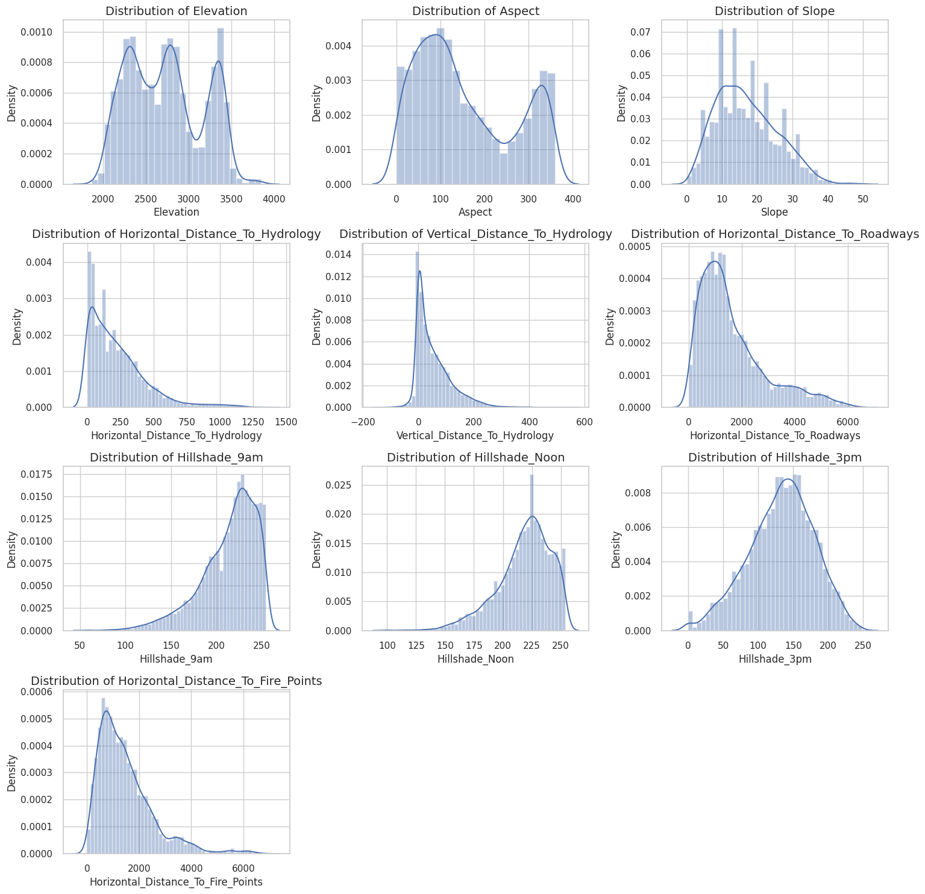
Distribution For Training Data

Slide 9
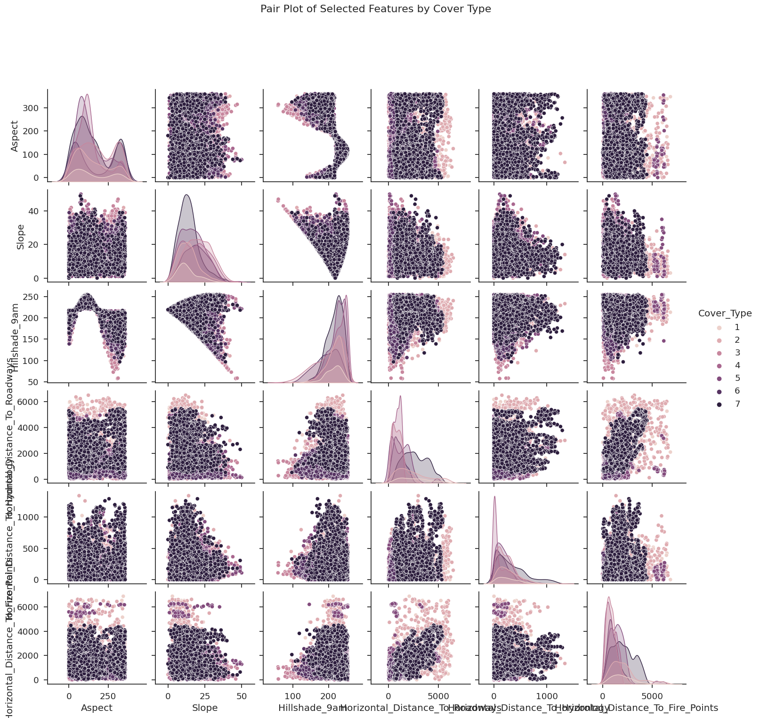
Pair Plot to show Relations Between Different Features

Slide 10
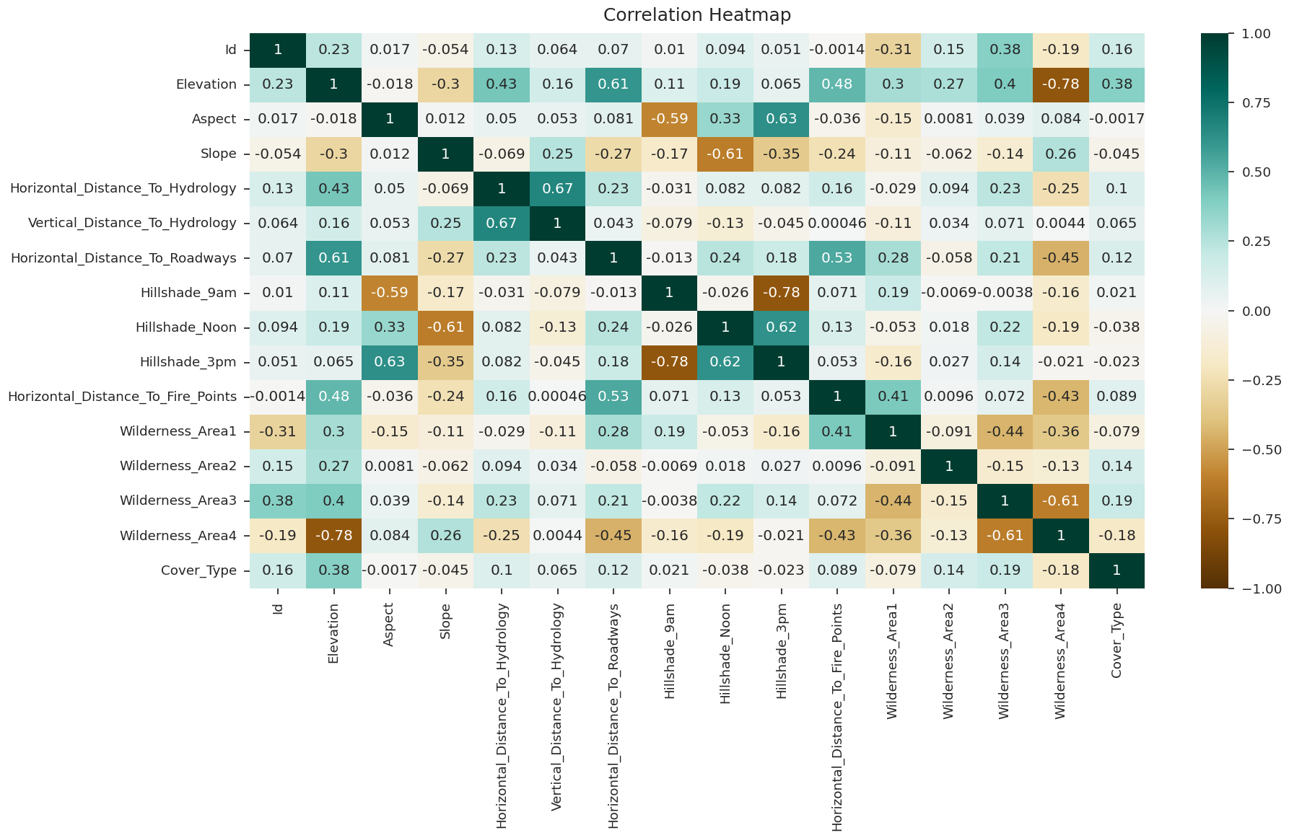
Correlation Matrix

Slide 11
03
Flowchart Of All Processes

Slide 12
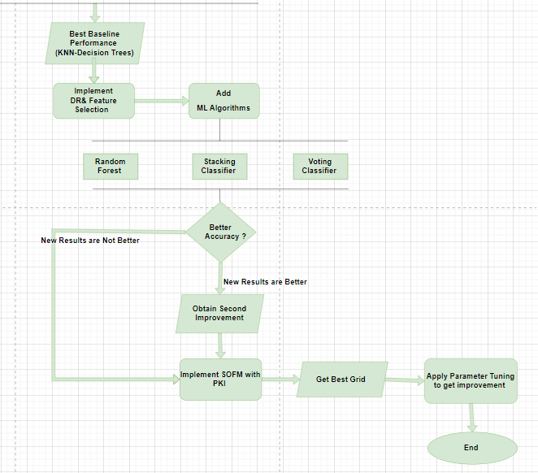
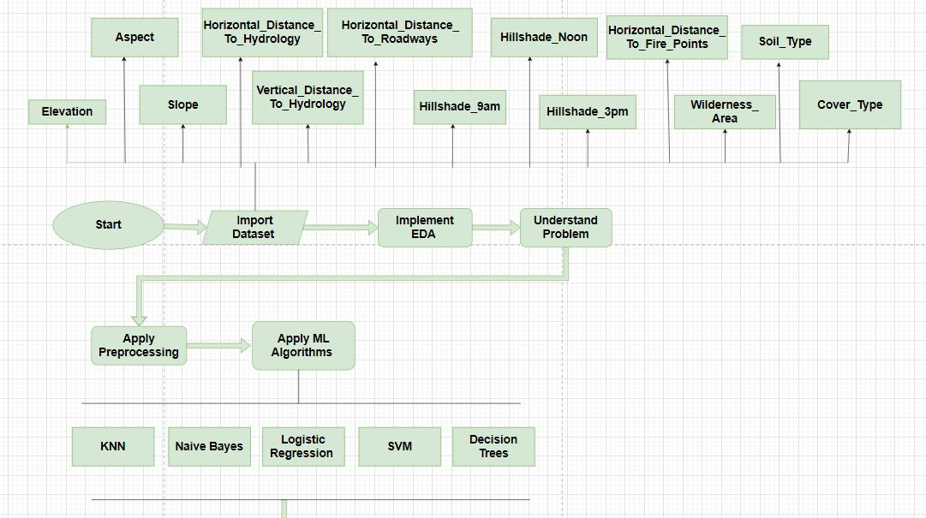

Slide 13
04
Problem Nature

Slide 14
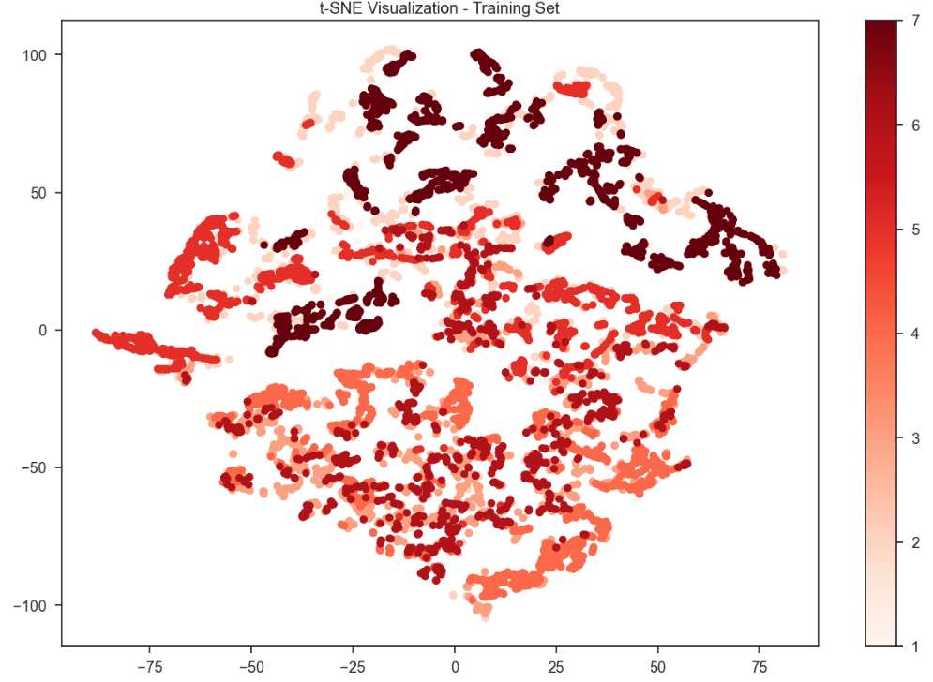
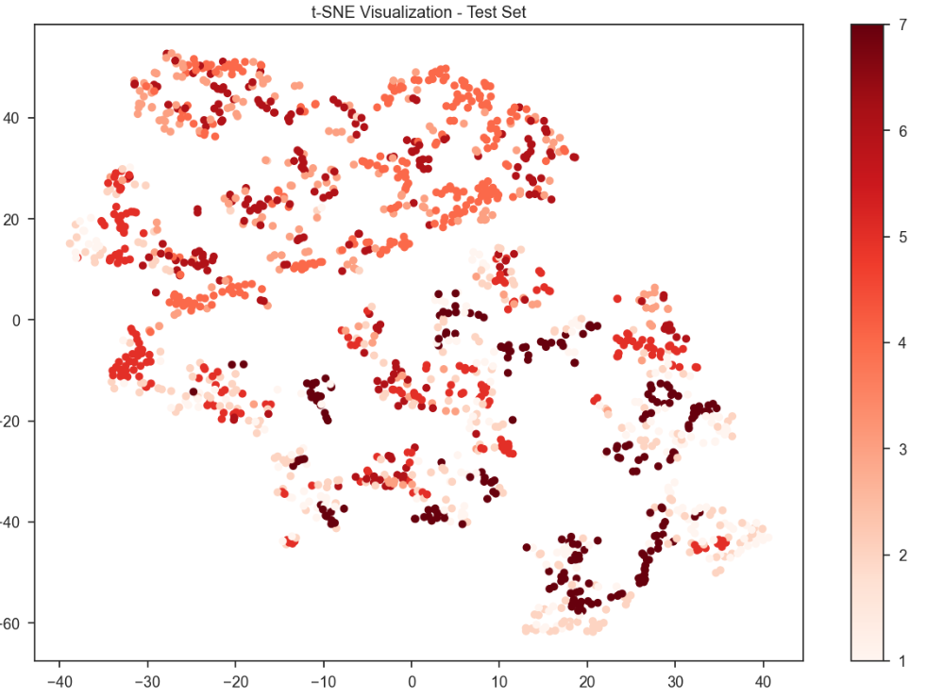
TSNE plot for training and test set to understand the complexity of the problem

Slide 15
Obtaining a baseline performance
Model | Test Accuracy | Validation Accuracy
KNN | 0.73836 | 0.75233
Naive Bayes | 0.60131 | 0.59946
Decision Tree | 0.75475 | 0.76301
SVM | 0.56131 | 0.55006
Logistic Regression | 0.62229 | 0.62149

Slide 16
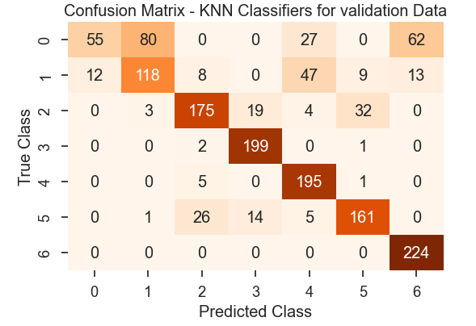
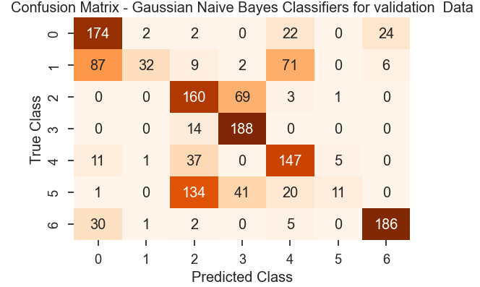
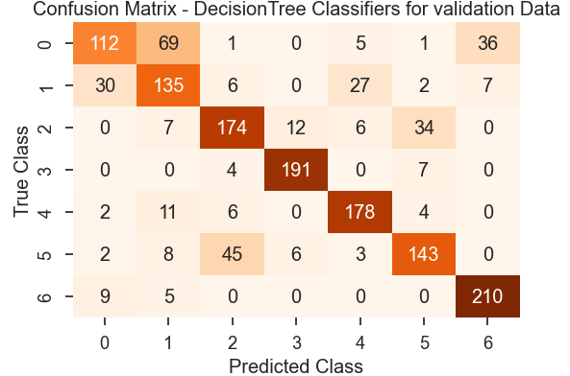
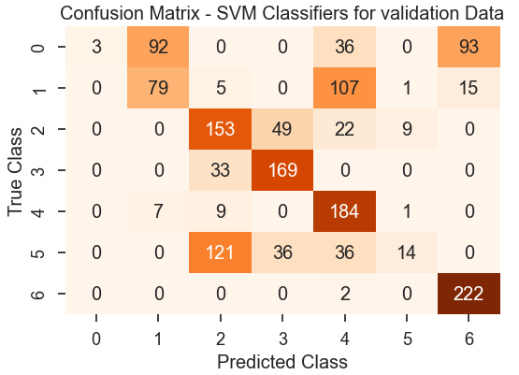
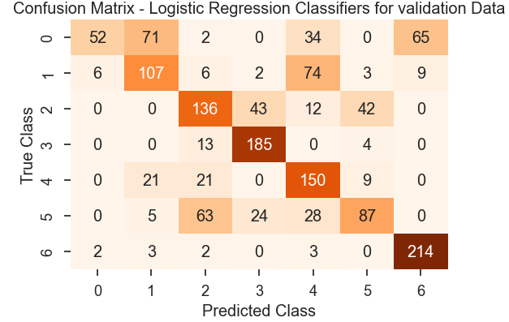
Confusion Matrix (Validation Data)

Slide 17
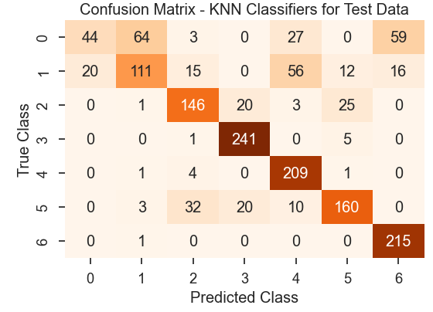
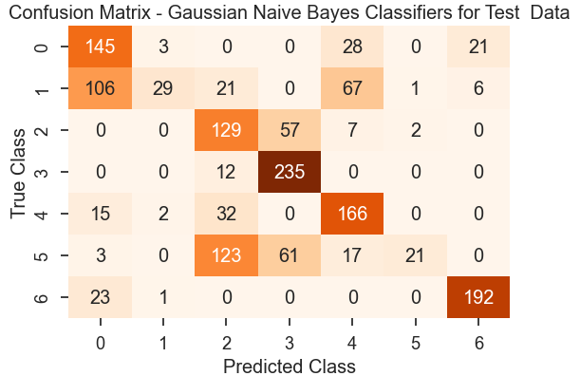
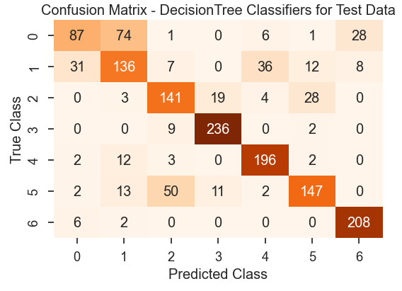
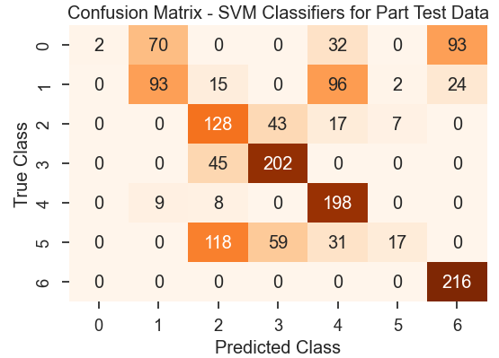
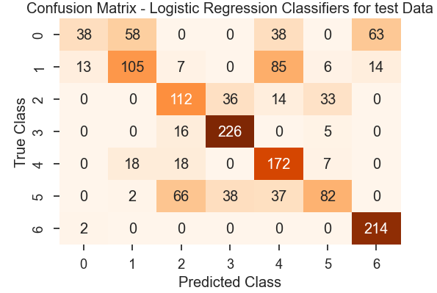
Confusion Matrix (Test Data)

Slide 18
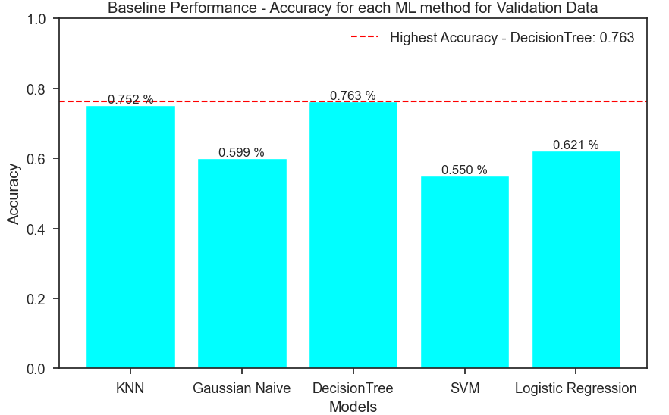
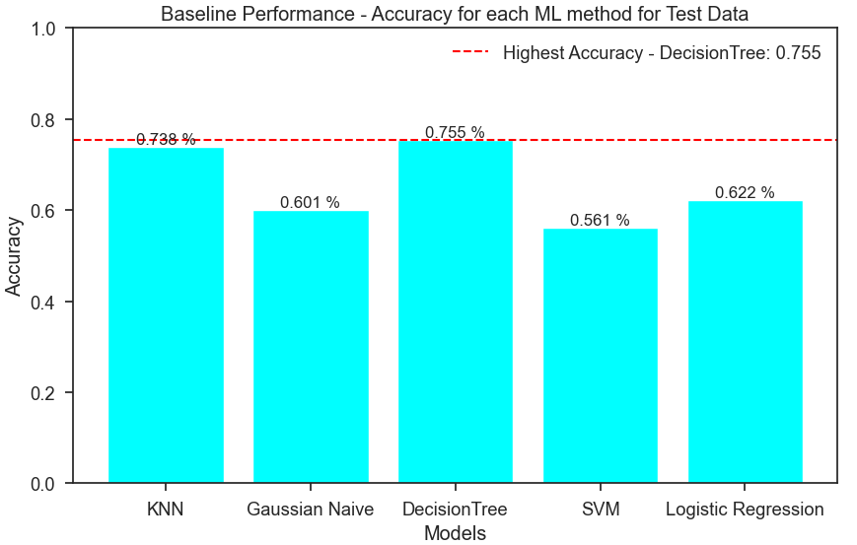
Comparison Between All Models To Know Highest Accuracy

Slide 19
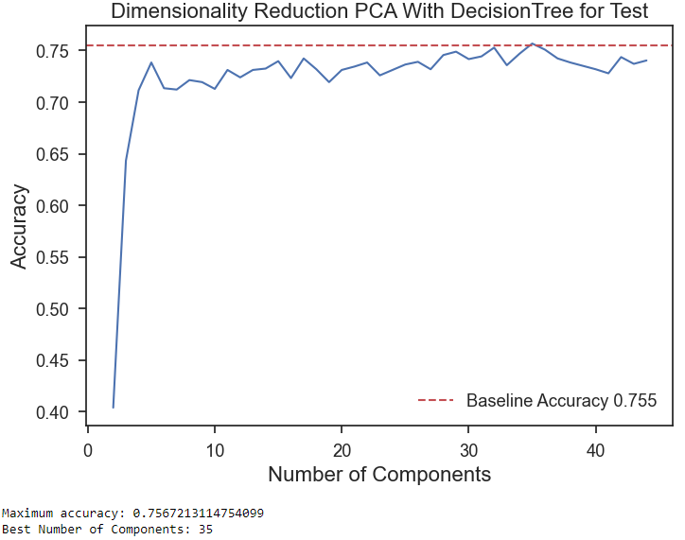
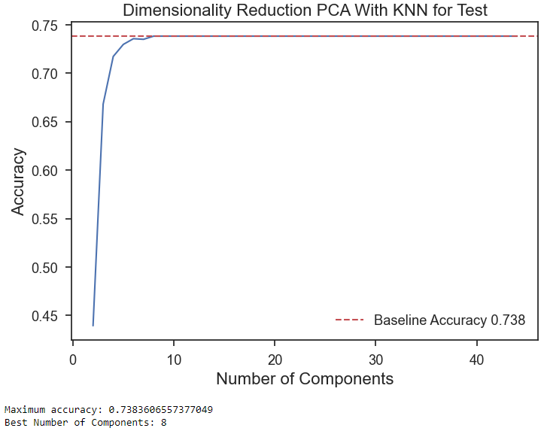
Dimensionality Reduction
Dimensionality Reduction PCA With Decision Trees and KNN

Slide 20
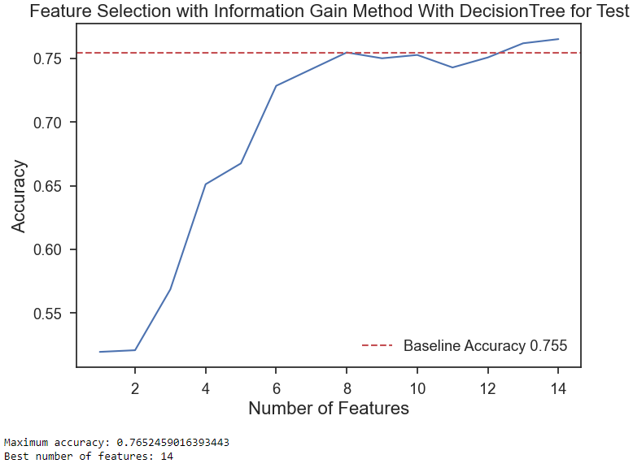
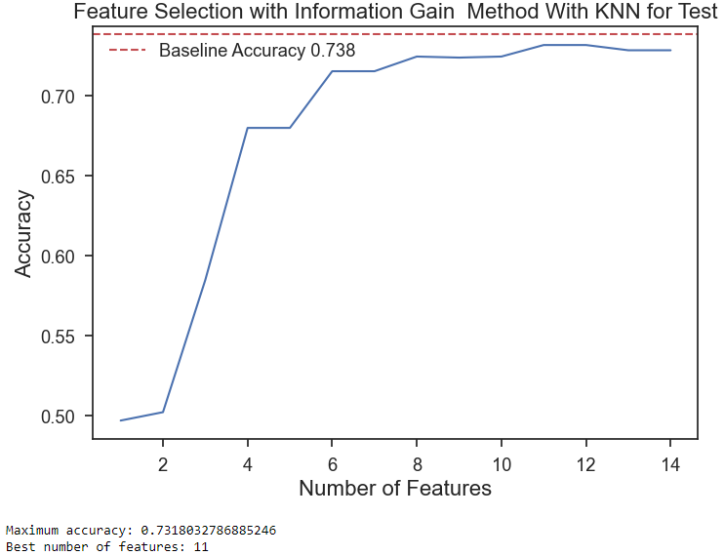
Feature Selection
Filter Based Approach
Decision Tree
KNN

Slide 21
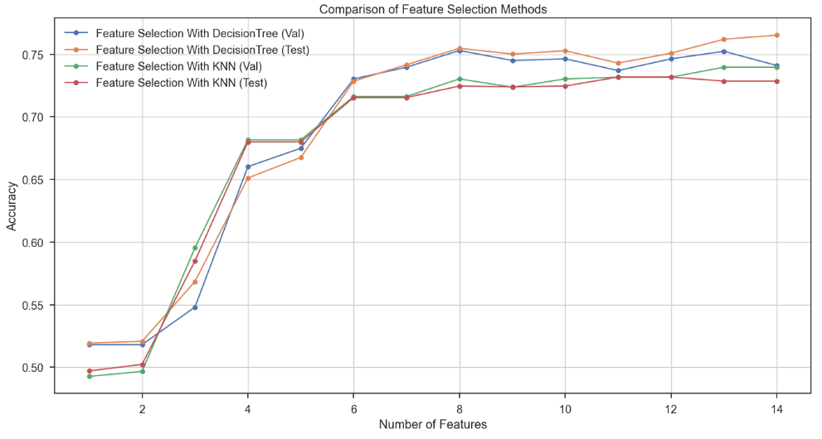
Feature Selection
Filter Based Approach
Comparison of Filter Based Approach for KNN and Decision Tree

Slide 22
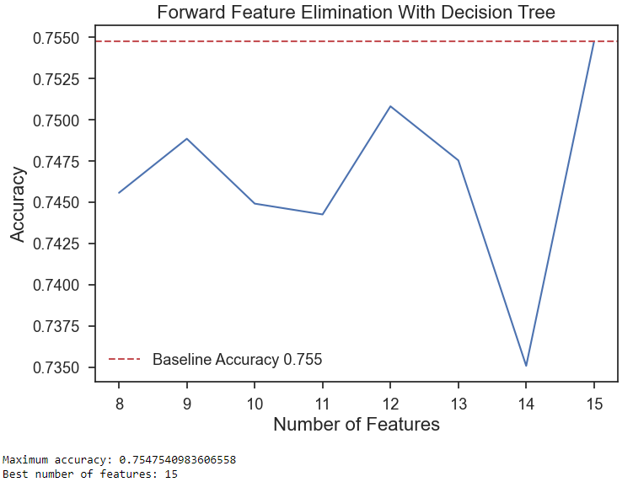
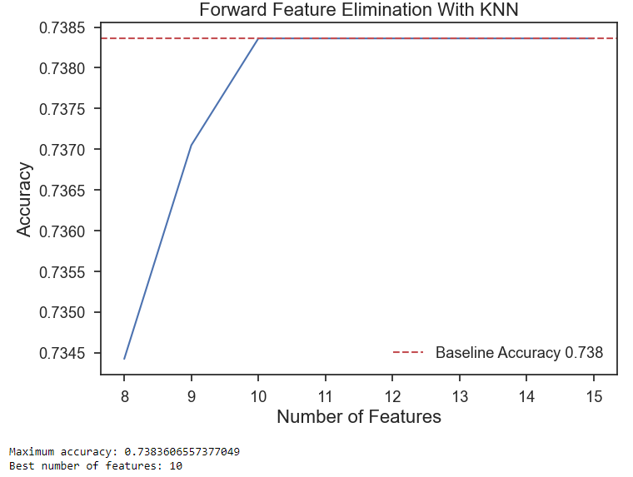
Feature Selection
Wrapper Based Approach
Decision Tree
KNN

Slide 23
Adding More ML Algorithms
Model | Test Accuracy
Decision Tree | 0.76393
Random Forest | 0.80721
Voting classifier | 0.80393
Stacking Classifier | 0.82557

Slide 24
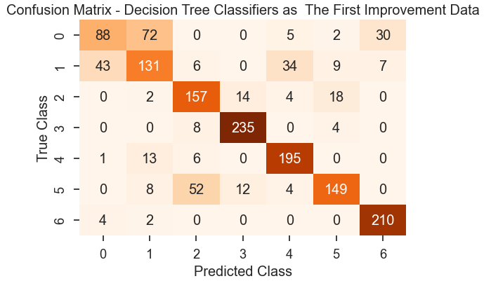
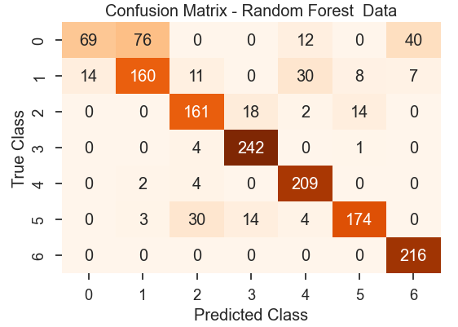
Adding More ML Algorithms

Slide 25
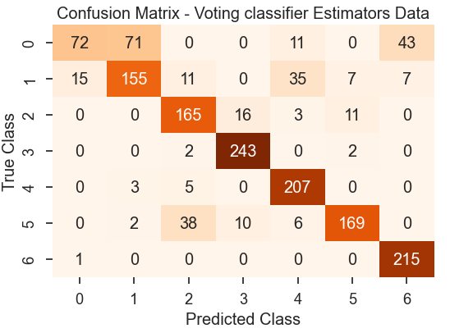
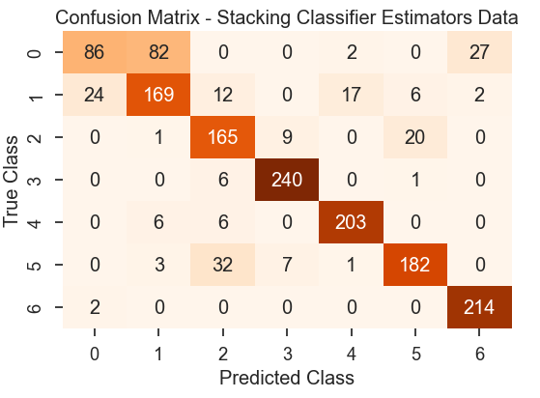
Two Ensemble Techniques to get Better Performance.

Slide 26
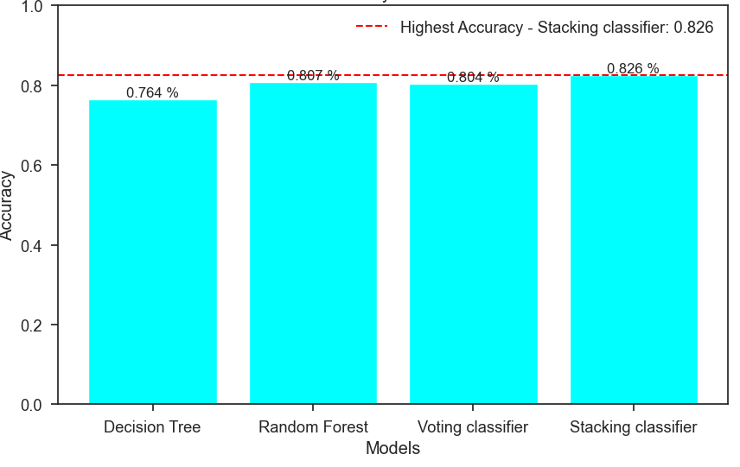
Comparison Between Models To Know Highest Accuracy After Adding More Models
The Second Improvement is Stacking Classifier ensample technique

Slide 27
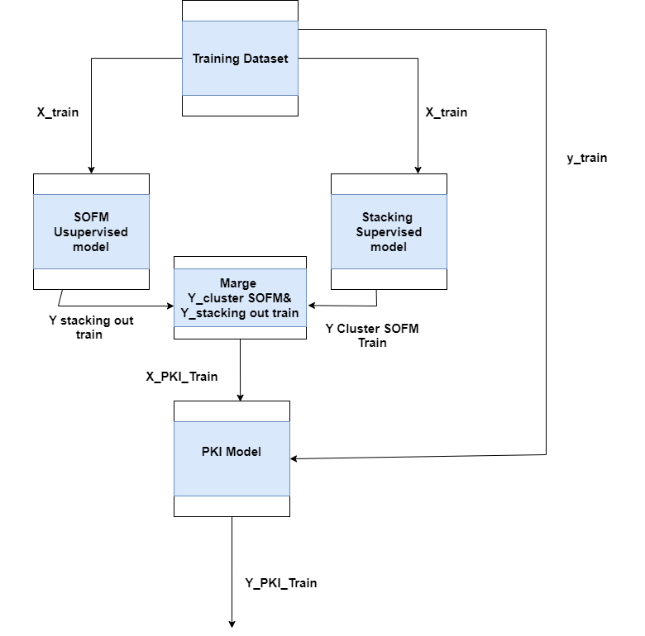
PKI Learning

Slide 28
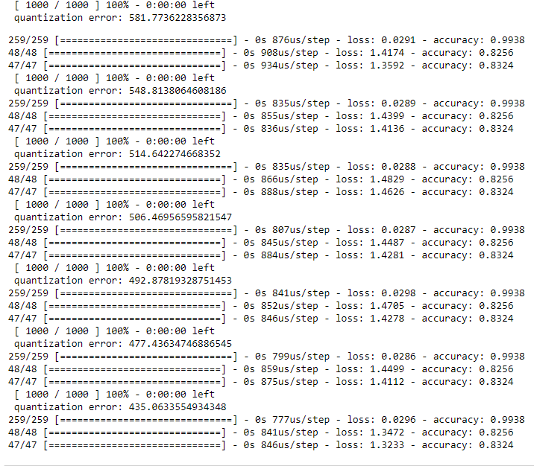
Supervised & Unsupervised Combination via PKI
We choose smaller Quantization Error to Get Best Grid size
SOFM Grid Sizes VS PKI Accuracy

Slide 29
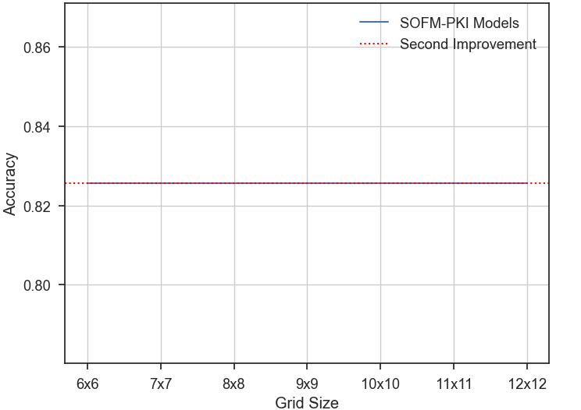
Accuracy vs Grid size With The Second Improvement for SOFM

Slide 30
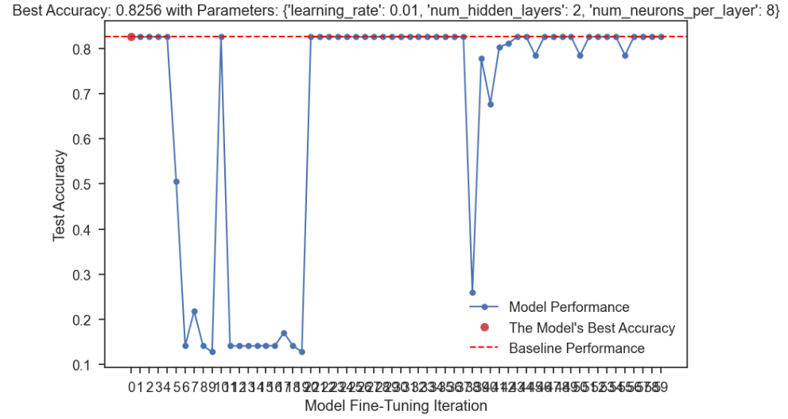
Parameter Fine Tuning

Slide 31
05
Conclusion

Slide 32
KNN and Decision Tree achieve the highest Accuracy.
Filter Based Approach Gives the best accuracy with Decision tree as the first Improvement.
After Adding More ML Models We Get the Second Improvement By Stacking Classifier.
PKI did not achieve any Improvement.
After applying parameter fine tuning we noticed no change in accuracy

Slide 33
THANKS

